Slide 1
Steps Toward Developing an Intelligent Robotics Course
Kutztown University
PACISE 2011
April 9, 2011
Oskars J. Rieksts
Jeffrey W. Minton
Notes:
2007
Oskars J. Rieksts

Slide 2
Acknowledgments – Funding
CS Department & LAS College
TYCO Electronics Foundation
Kutztown University Foundation
KU Faculty Professional Development Committee
KU Undergraduate Research Committee
PASSHE Faculty Professional Development Council
2011
Kutztown University

Slide 3
Motivations
Rodney Brooks
DARPA Grand Challenge
REU @ Auburn
Hardware-software synthesis
  “Hardened” hardware
  Central role of software
Applied A.I.
Applied cognition
2011
Kutztown University

Slide 4
Motivations
Mobility
Assistive robotics
  Robotic wheelchairs
2011
Kutztown University

Slide 5
Outline
Early efforts
  Hacking Roomba & other ventures
  Research Experience for Undergraduates
  Create and Mindstorms
  Captain KURK
  Trinity firefighting contest
  Myro and Python
  Reading-Berks Science Fair
2011
Kutztown University

Slide 6
Coming into Focus
Emerging goals
  Intelligence
  Vision
  Communcation
  Philosophical issues
Point of convergence – robotics course
  Control
  Image processing
Vision
  font 40
Communication
  font 40
2011
Kutztown University

Slide 7
Point of convergence
Course in intelligent robotics
  Control
  Vision
  Communcation
  Investigate cognitive issues
    Stratton – spatial harmony of sight and touch
Point of convergence – robotics course
  Control
  Image processing
Vision
  font 40
Communication
  font 40
2011
Kutztown University

Slide 8
Investigate cognitive issues
Sight and touch
  George Stratton
    Spatial harmony of sight & touch
  Benjamin Kuipers
    Semantic spatial hierarchy
  Harnad – symbol grounding problem
  Investigate cognitive issues
    Stratton – spatial harmony of sight and touch
Point of convergence – robotics course
  Control
  Image processing
Vision
  font 40
Communication
  font 40
2011
Kutztown University

Slide 9
The Trinity Robot
VEX chasis
  font 40
Asus Eee PC
Arduino microcontroller
Hercules Classic Silver
  font 40
Sonar
  Parallax Ping))) Ultrasonic Rangefinder
2011
Kutztown University

Slide 10
Brobi – hardware
Create chasis
  font 40
EEE netbook
  font 40
Microsoft Lifecam
  font 40
Arduino microcontroller
  font 40
2011
Kutztown University

Slide 11
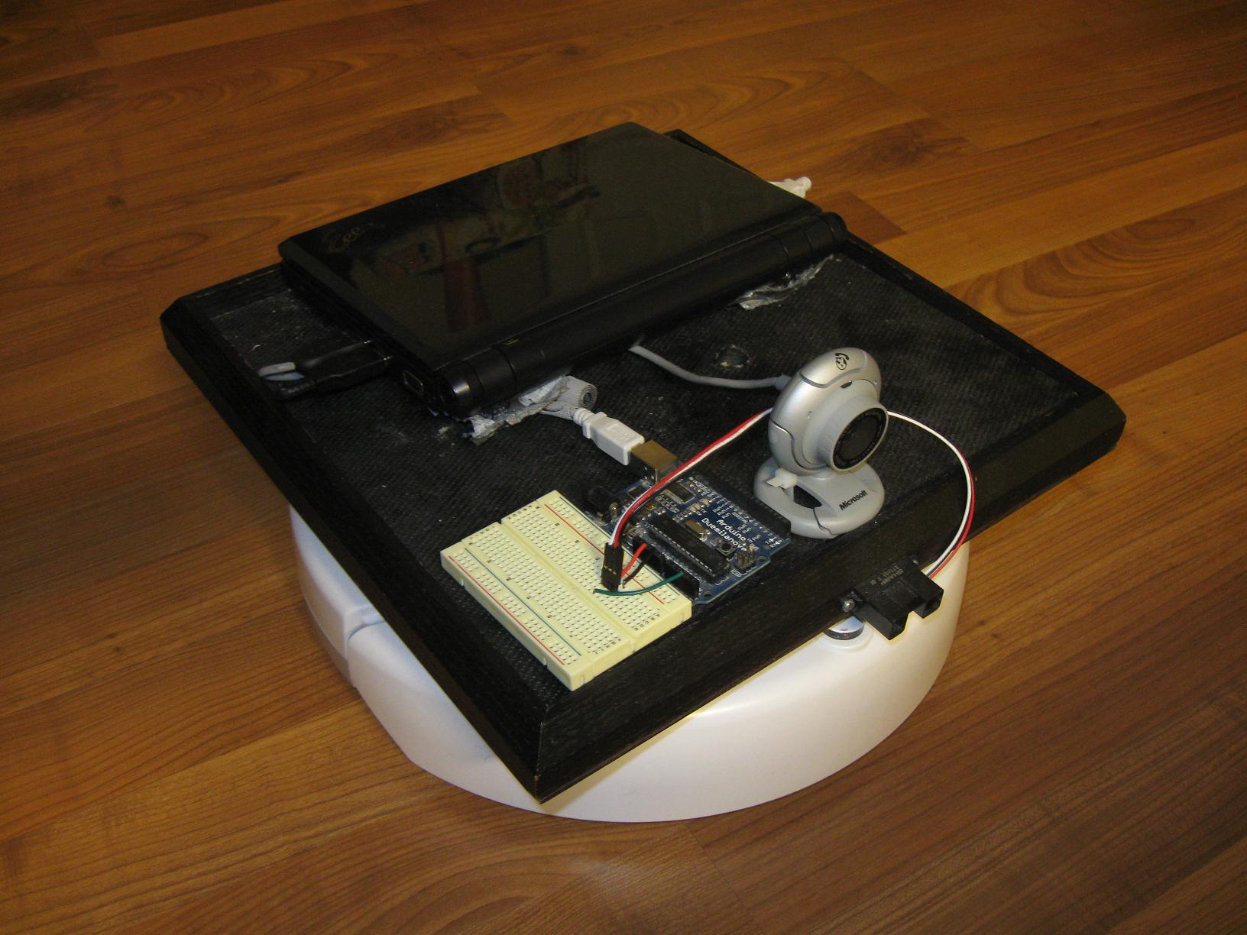
Brobi
2011
Kutztown University

Slide 12
Brobi – software
OpenCV and Python
Consultation – John Spletzer
  Lehigh
  Little Ben in Urban Challenge
MATLAB
  Image processing
  Create API
  A programming language
2011
Kutztown University

Slide 13
Template
Font 44
  font 40
Font 44
  font 40
Font 44
  font 40
Font 44
  font 40
2011
Kutztown University

Slide 14
Template
Font 44
  font 40
Font 44
  font 40
Font 44
  font 40
Font 44
  font 40
2011
Kutztown University

Slide 15
Template
Font 44
  font 40
Font 44
  font 40
Font 44
  font 40
Font 44
  font 40
2011
Kutztown University

Slide 16
Template
Font 44
  font 40
Font 44
  font 40
Font 44
  font 40
Font 44
  font 40
2011
Kutztown University

Slide 17
Template
Font 44
  font 40
Font 44
  font 40
Font 44
  font 40
Font 44
  font 40
2011
Kutztown University

Slide 18
Template
Font 44
  font 40
Font 44
  font 40
Font 44
  font 40
Font 44
  font 40
2011
Kutztown University

Slide 19
Template
Font 44
  font 40
Font 44
  font 40
Font 44
  font 40
Font 44
  font 40
2011
Kutztown University

Slide 20
Template
Font 44
  font 40
Font 44
  font 40
Font 44
  font 40
Font 44
  font 40
2011
Kutztown University

Slide 21
Template
Font 44
  font 40
Font 44
  font 40
Font 44
  font 40
Font 44
  font 40
2011
Kutztown University

Slide 22
Template
Font 44
  font 40
Font 44
  font 40
Font 44
  font 40
Font 44
  font 40
2011
Kutztown University

Slide 23
Template
Font 44
  font 40
Font 44
  font 40
Font 44
  font 40
Font 44
  font 40
2011
Kutztown University

Slide 24
Template
Font 44
  font 40
Font 44
  font 40
Font 44
  font 40
Font 44
  font 40
2011
Kutztown University

Slide 25
Template
Font 44
  font 40
Font 44
  font 40
Font 44
  font 40
Font 44
  font 40
2011
Kutztown University

Slide 26
Template
Font 44
  font 40
Font 44
  font 40
Font 44
  font 40
Font 44
  font 40
2011
Kutztown University

Slide 27
Template
Font 44
  font 40
Font 44
  font 40
Font 44
  font 40
Font 44
  font 40
2011
Kutztown University

Slide 28
Template
Font 44
  font 40
Font 44
  font 40
Font 44
  font 40
Font 44
  font 40
2011
Kutztown University

Slide 29
Template
Font 44
  font 40
Font 44
  font 40
Font 44
  font 40
Font 44
  font 40
2011
Kutztown University

Slide 30
Template
Font 44
  font 40
Font 44
  font 40
Font 44
  font 40
Font 44
  font 40
2011
Kutztown University

Slide 31
Template
Font 44
  font 40
Font 44
  font 40
Font 44
  font 40
Font 44
  font 40
2011
Kutztown University

Slide 32
Template
Font 44
  font 40
Font 44
  font 40
Font 44
  font 40
Font 44
  font 40
2011
Kutztown University

Slide 33
Template
Font 44
  font 40
Font 44
  font 40
Font 44
  font 40
Font 44
  font 40
2011
Kutztown University

Slide 34
Template
Font 44
  font 40
Font 44
  font 40
Font 44
  font 40
Font 44
  font 40
2011
Kutztown University

Slide 35
Template
Font 44
  font 40
Font 44
  font 40
Font 44
  font 40
Font 44
  font 40
2011
Kutztown University

Slide 36
Template
Font 44
  font 40
Font 44
  font 40
Font 44
  font 40
Font 44
  font 40
2011
Kutztown University

Slide 37
Template
Font 44
  font 40
Font 44
  font 40
Font 44
  font 40
Font 44
  font 40
2011
Kutztown University

Slide 38
Template
Font 44
  font 40
Font 44
  font 40
Font 44
  font 40
Font 44
  font 40
2011
Kutztown University

Slide 39
Template
Font 44
  font 40
Font 44
  font 40
Font 44
  font 40
Font 44
  font 40
2011
Kutztown University

